Slide 1
DATA MINING
Matching Entities Across Online Social Networks
Project Members:
Jesal Janani
Prasanna Pai
Susana D’sa

Slide 2
Agenda
Problem Description
Approach
Description of Data
Results
Case
Demo

Slide 3
PROBLEM DESCRIPTION
Online User’s social linkages to map user profiles on different social networking websites
Using various procedures and mapping algorithms to map user profiles to same user on different websites
Mapping on the basis of personal information and user feeds and notifications

Slide 4
APPROACH
Information Retrieval algorithms and mapping processes such as Vector Space Model, TF-IDF model has been used
TF-IDF similarity model was found to be efficient in our case since it can map the similarity of the user’s profile on social networks with ease
Normalization vector to map the user profiles on the basis of available attributes
User attributes mapped on feature space model and each attribute normalized to get a score for each attribute.

Slide 5
DESCRIPTION OF DATA
For this project we have limited our data to Facebook and Twitter profiles
We have used APIs to obtain selective profiles and saved them in a database – POSTGRE
Our main dataset is Facebook and hence for 1 profile on Facebook, we have fetched 1 or more profiles on Twitter

Slide 6
PARAMETERS CONSIDERED
FACEBOOK
Name
Username
Description
Location
Email
Website link
Verified profile
TWITTER
Name
Twitter Handle
Description
Location
Website link
Verified profile

Slide 7


RESULTS
We used Similarity score by creating inverted index on various parameters and calculated the TF-IDF scores.
Term frequency score
Inverse document frequency
TF-IDF formula:
For a given Facebook profile, we could get 1 or more Twitter profiles that provide a good score and a possible match

Slide 8
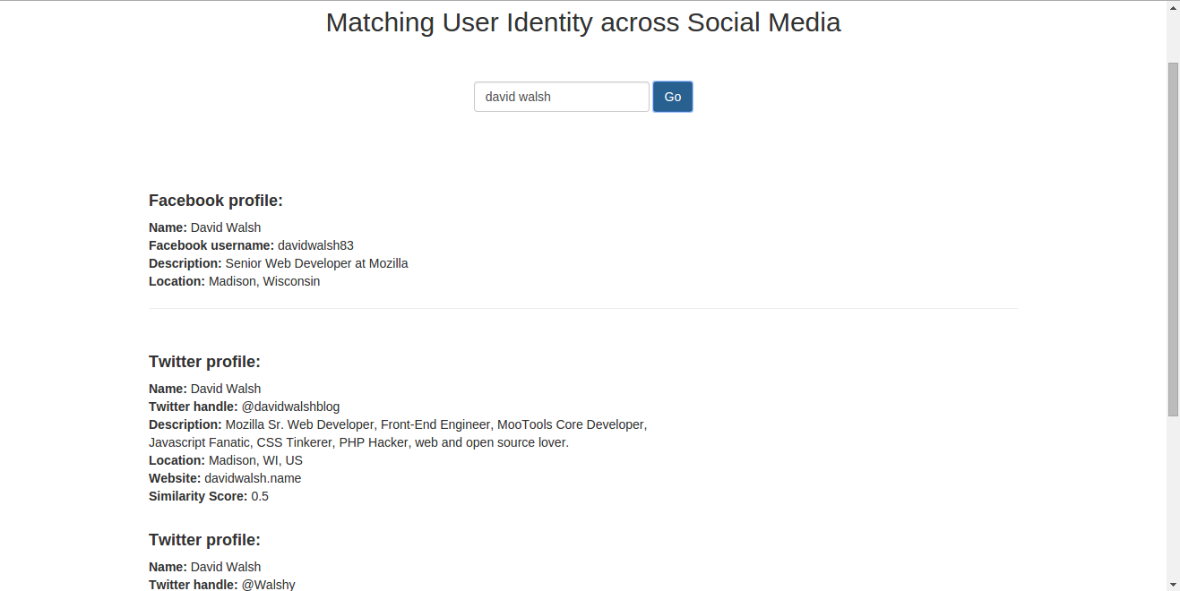

Slide 9
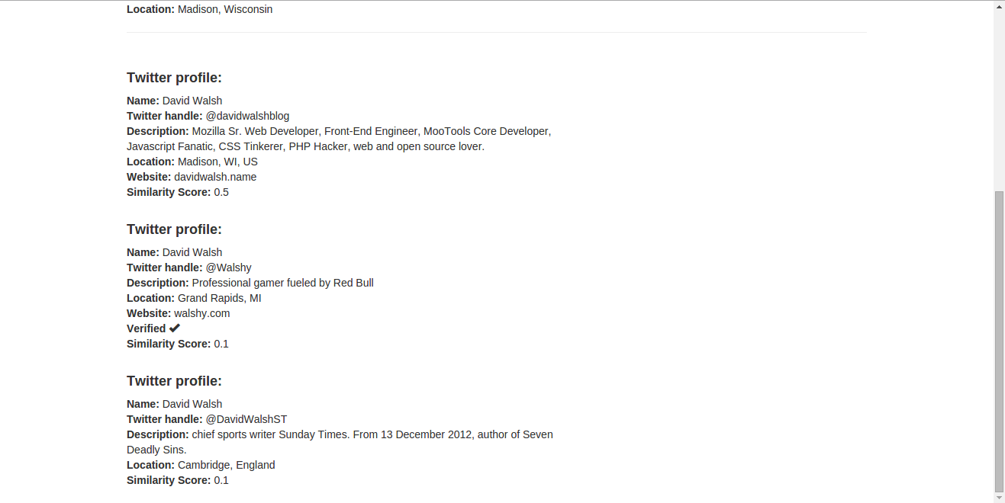

Slide 10

DEMO

Slide 11

THANK YOU

